Slide 1

SecureCoding
Validation and Sanitization

Slide 2

Securing your web application
Application
User
Input
Input Validation
Output
Sanitization
Output
User

Slide 3
middleware
A middleware is basically a function that will the receive the Request and Response objects. As a third argument you have another function that will call the next middleware function, if there is one.
Usually there is a middleware chain, meaning a chain of functions that are called one after the other, with the last function sending the response back to the browser.
You must call next() (unless it’s the last function in the chain) or the request will just hang and eventually timeout.
Any changes you make to req or res will be available in the next middleware function.

Slide 4
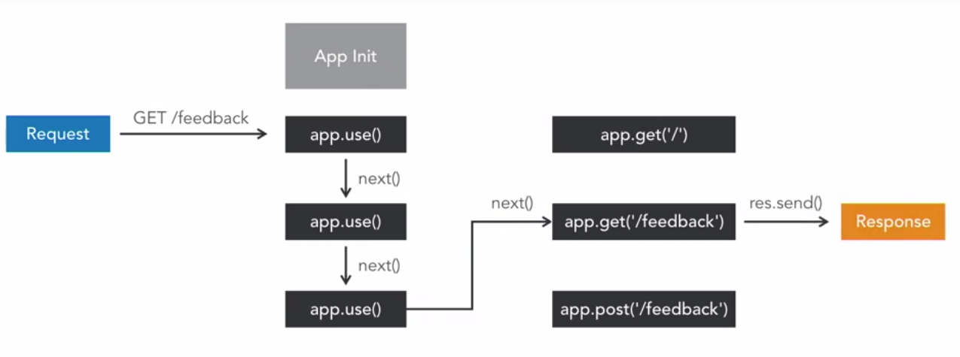
middleware

Slide 5
Securing a node js app
Input validation and output sanitization can be applied as part of middleware functions
Middleware to validate input before the input is processed
Middleware to sanitize the output before the output is returned to client

Slide 6
Two standard controls against XSS
Validate all user controlled input including form fields, GET and POST parameters, headers and cookies. Only whitelisted characters should be allowed and special HTML characters should certainly not be allowed. In practice this is tricky to get right.
Escape all strings output to the page. Any HTML special character will be HTML encoded and interpreted by the browser literally rather than as HTML markup.

Slide 7
Validation-Regular Expressions
Applications frequently require text processing for features like word searches, email validation, or XML document integrity. This often involves pattern matching
RegExp is inbuilt and supported within JS.

Slide 8
Wildcard Characters
* - Match 0 or more occurrences
? - Match 0 or 1 occurrence
+ - Match 1 or more occurrences
{x} - Match exactly x times
{x,y} – Match between x(inclusive) to y(inclusive) occurrences
[123x] - Match a single instance of any character in the brackets
[0-9] - Shorthand for [0123456789], often used with [A-Z]
[^0-9] - Match a single character except those specified in brackets

Slide 9
Useful predefined classes
. Any character
\d A digit: [0-9]
\D A non-digit: [^0-9]
\s A whitespace character
\S A non-whitespace character: [^\s]
\w A word character: [a-zA-Z_0-9]
\W A non-word character: [^\w]

Slide 10
Logical Operators
XY : X followed by Y
X|Y: Either X or Y
(X) : X, as a capturing group Example:
([13]x)|([ab]3) pattern will match 1x,3x,a3,b3

Slide 11
Using Regular Expressions
Steps to follow: 1) Define the regular expression to search 2) Check input against the regular expression 3) Block or allow operation to continue depending on the regular expression check

Slide 12
Simple Email Validation
var userinput=“abc@gmail.com”;
pattern=new RegExp(‘^.+@.+\.[a-z]+$’);//create regex with a pattern
if(pattern.test(userinput)){
console.log(“Input is correct!”);
}else{
console.log(“Input does not match pattern!”);
}

Slide 13
Analyzing the Expression
Analyzing the regular expression: .+@.+ \. [a-z]+
At least 1 character
At least 1 lower case alphabet

Slide 14
Other simple regular expression samples
To check if target string is digit type: \d+ OR [0-9]+
To check if target string is just composed of alphabets: [a-zA-Z]+
To check if target string is alphanumeric type: [a-zA-Z0-9]+

Slide 15
External libraries for validation
Example js node validator library (https://www.npmjs.com/package/validator).
npm install validator --save
This library helps you to validate and sanitize strings in your application.
Common functions to help you validate emails, credit cards, urls etc are already defined in the library and you can use it like an api

Slide 16
Validator example
Validation checks that will be performed on input fields:
Input Username field contains only alphabets and/or digits
Input Email field must be a valid email
Input Role must be either “user” or “admin”
Input Password contains only alphabets and/or digits
Input Password must be 8 or more characters

Slide 17
Validator example
var validator=require('validator');
function validateRegistration(req,res,next){
var username=req.body.username;
var email=req.body.email;
var role=req.body.role;
var password=req.body.password;
if (validator.isAlphanumeric(username) && validator.isEmail(email) && (role=='user' || role=='admin') && validator.isAlphanumeric(password) && password.length>7){
next();
}
else{
res.send(`{"Message":"Validation Failed"}`);
}
}
module.exports.validateRegistration=validateRegistration;

Slide 18
Applying the middleware function
var validate=require('../validate/validate.js');
app.post('/api/user',…,validate.validateRegistration, function(req,res){
…
}

Slide 19
Sanitization
Process of removing or replacing submitted data
After validation and processing, we can sanitize data to ensure outputted data is safe
The validator library provides functions to sanitize data

Slide 20
Escaping data
Characters such as <,>,&,’,”,/ should be converted to the corresponding HTML entites, so that they won’t be interpreted as code like javascript in xss attacks
Sample code:
var validator=require('validator');
var input=“<script>alert(‘JS XSS!’);</script>”;
var sanitizedOutput=validator.escape(input);

Slide 21
Remove line breaks, tabs and extra white space
Validator has a stripLow() function that removes ASCII control characters, which are normally invisible in HTML
Sample code:
var validator=require('validator');
var input=“Hi there!\r\n Welcome to Secure Coding ”;
var sanitizedOutput=validator.stripLow(input);

Slide 22
Securing input and output
Perform validation on input data
Perform Sanitization on output data
Apply validation/sanitization middleware accordingly to the API routes

